Slide 1
Personalized Music Recommendation Systems
IISc CDS Cohort 7, Group 7

Slide 2
Our Goals and Vision
Vision
To create a music recommendation system that leverages the rich, contextual data from the Million Musical Tweets Dataset to provide highly personalized and accurate music recommendations to users.
Goal
Develop a music recommendation system that uses machine learning algorithms to analyze listening patterns, preferences, and contextual information to suggest songs, albums, or artists that users are likely to enjoy.

Slide 3
The Team
Karthik Palaniappan, Ajay Shriwastava, Chandra Mouli Mudumba, Srinivas Chakravarthy, Saurav Kumar, Praneet Nadkar, Randhir Singh, Nilesh Tompe With additional thanks to Srihari Karnam and Aparna Badkundri Mentor: Tanmay Sachan

Slide 4

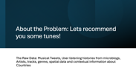

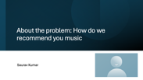





Presentation Outline: Roadmap

Slide 5

About the problem: How do we recommend you music
Saurav Kumar

Slide 6
About the Problem: Lets recommend you some tunes!
The Raw Data: Musical Tweets, User listening histories from microblogs, Artists, tracks, genres, spatial data and contextual information about Countries

Slide 7
Our Dataset
Before we dig deep into the problem we are trying to achieve. Let's understand the following:
MMTD - Million Musical Tweets Dataset Corpus of Music Microblogging Behavior (2011-11-09 to 2013-04-30)
The research paper
The Million Musical Tweets Dataset - What We Can Learn From Microblogs Hauger, D. and Schedl, M. and Košir, A. and Tkalčič, M. Proceedings of the 14th International Society for Music Information Retrieval Conference (ISMIR 2013), Curitiba, Brazil, November 2013.

Slide 8
Dataset Listening Events
The data set contains listening histories inferred from microblogs. Each listening event identified via twitter-id and user-id is annotated with: Temporal - date, time, weekday, timezone Spatial - longitude, latitude, continent, country, county, state, city Contextual (information on the country) information In addition, pointers to artist and track are provided as a matter of course. The data includes references to other music-related platforms - lastfm, musicbrainz, 7digital, amazon.

Slide 9
About the Problem: Lets recommend you some tunes!
The Raw Data: Musical Tweets, User listening histories from microblogs, Artists, tracks, genres, spatial data and contextual information about Countries

Slide 10
The MMTD Dataset – orientation (2 min)
The Million Musical Tweets Dataset (MMTD) is a comprehensive collection of music listening histories inferred from microblogs, specifically Twitter. The dataset spans from November 2011 to April 2013 and includes over a million tweets that mention music listening events. Each listening event is identified by a unique Twitter ID and user ID, and is annotated with various metadata:
Temporal Information: Date, time, weekday, and timezone of the listening event.
Spatial Information: Longitude, latitude, continent, country, county, state, and city where the listening event occurred.
Contextual Information: Information about the country where the listening event took place.
Music Information: Pointers to the artist and track involved in the listening event.
References to Other Platforms: Links to other music-related platforms such as MusicBrainz, 7digital, and Amazon.
Genres: List of genres associated with the listening event

Slide 11
Exploratory Data Analysis ( 3 mins)
Chandra Mouli Mudumba

Slide 12
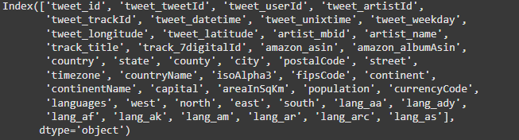
Let's get some EDA going on here
How is our data representative of the features, or what are our features that we are working with from a genres stand point?

Slide 13
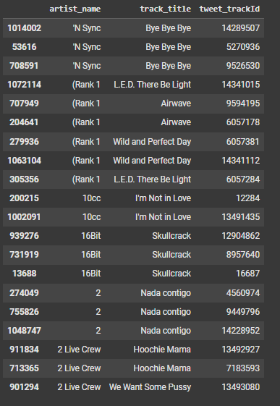
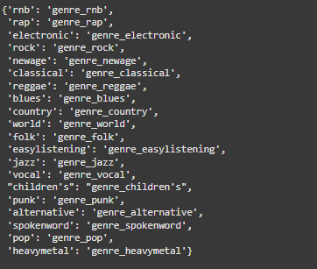
Genres, tracks and artists

Slide 14
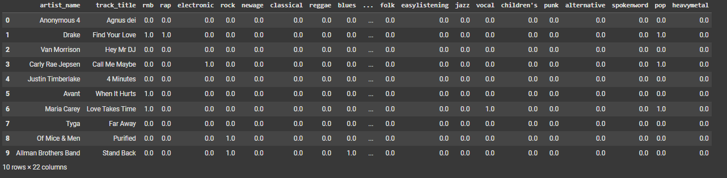
How unique are the tracks and artists

Slide 15
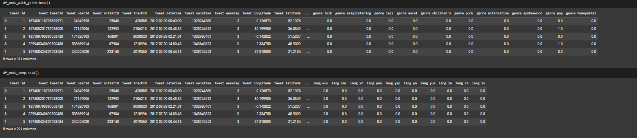
Combining MMTD and Genres

Slide 16
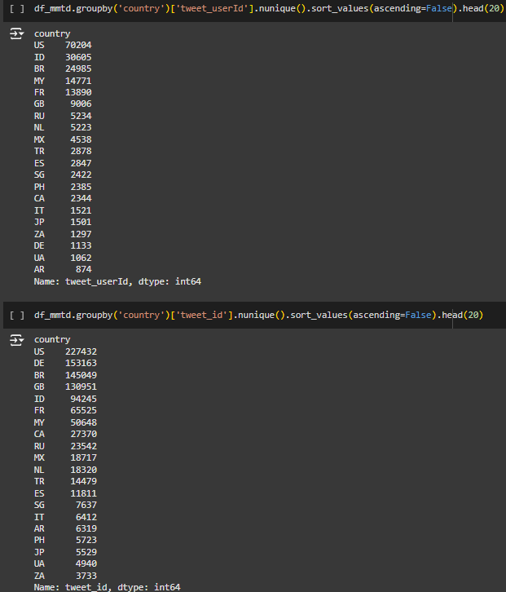
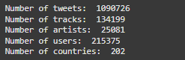
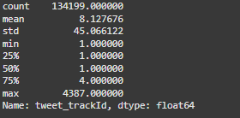
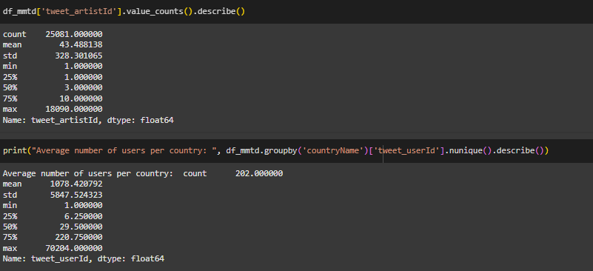
Music Tweets and Country

Slide 17
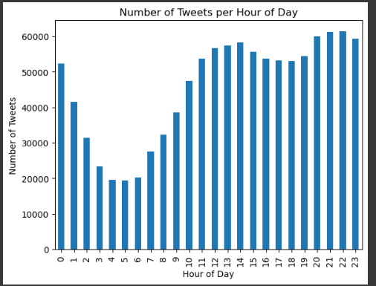
Frequency of Tweets with Hour of the day

Slide 18
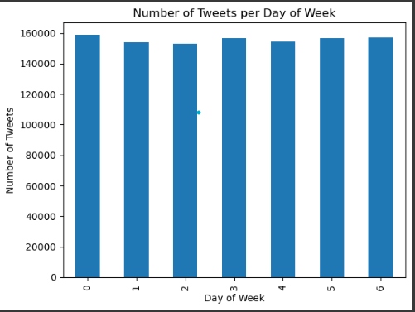
Number of Tweets per days of the week

Slide 19
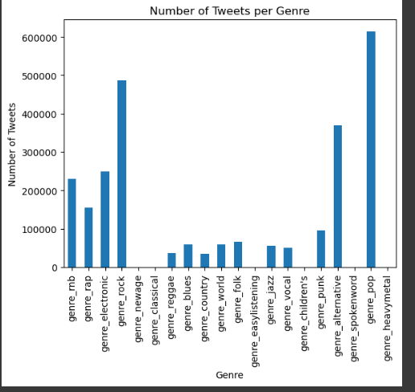
But I want to see how many tweets are trending by Genre of music
The argument continues between Rock and Heavy Metal

Slide 20
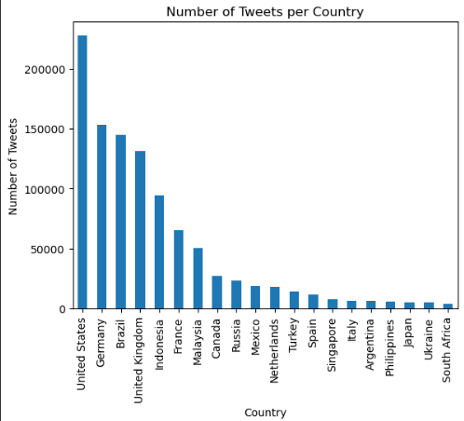
So are users dig Rock and Heavy Metal. They are either up in the night or early morning tweeting, but from where?

Slide 21
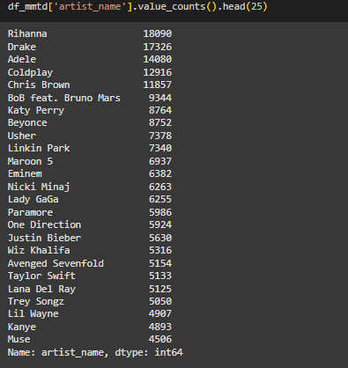
Who are our artists

Slide 22
Content Based Filtering (3 min)
Karthik Palaniappan

Slide 23
Consider a typical Bangalore Family

Slide 24

A Typical Bangalore Family
A hardworking senior person who retired recently after spending about 40 years at the same organization.
His wife, who devotes her time to social service.
Their daughter – who works for Infosys in the UK.
And their son-in-law, who is in-between jobs.

Slide 25

Can we provide music recommendations for one of them?

Slide 26
What if we know that they liked Taylor Swift?

Slide 27
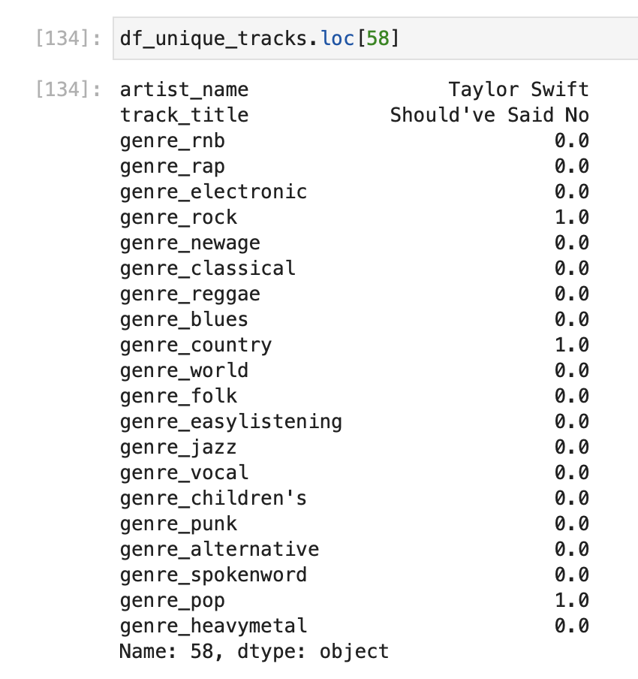
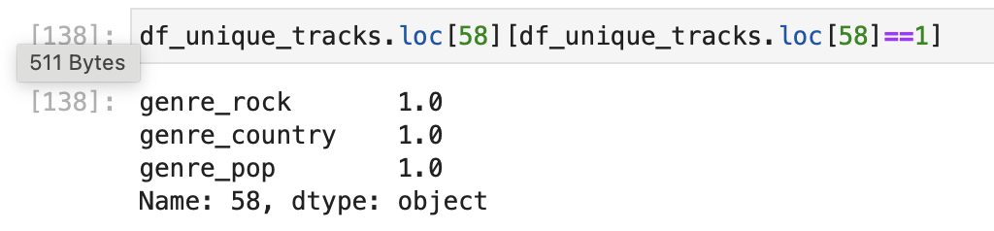
Let’s check the genres for a Taylor Swift Song…

Slide 28
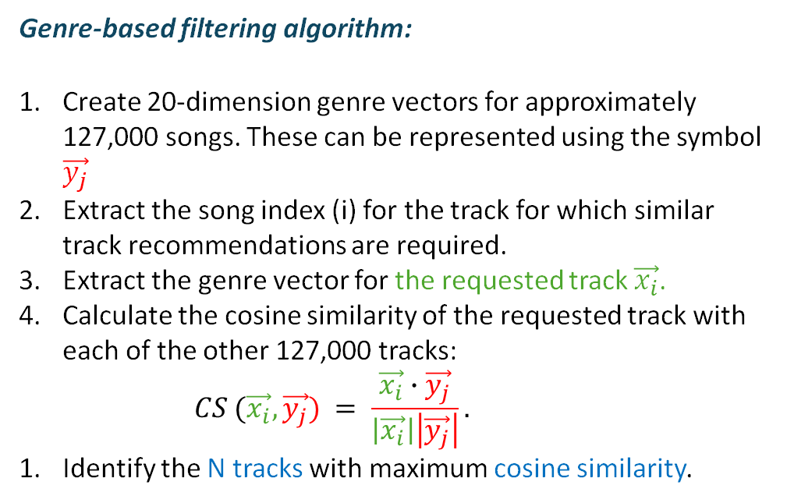
Simple Content-Based Filtering Algorithm
Genre-based filtering algorithm:
Create 20-dimension genre vectors for approximately 127,000 songs. These can be represented using the symbol $\vec{y_{j}}$
Extract the song index (i) for the track for which similar track recommendations are required.
Extract the genre vector for the requested track $\vec{x_{i}}$.
Calculate the cosine similarity of the requested track with each of the other 127,000 tracks:
$$CS (\vec{x_{i}}, \vec{y_{j}}) = \frac{\vec{x_{i}}∙\vec{y_{j}}}{\left|\vec{x_{i}}\right|\left|\vec{y_{j}}\right|}.$$
Identify the N tracks with maximum cosine similarity.

Slide 29
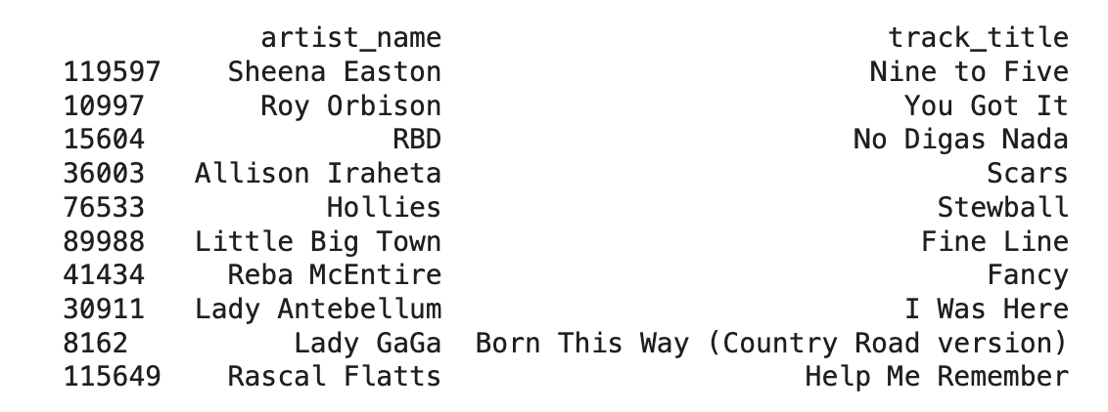
Songs Similar to Taylor Swift’s Should’ve said no

Slide 30
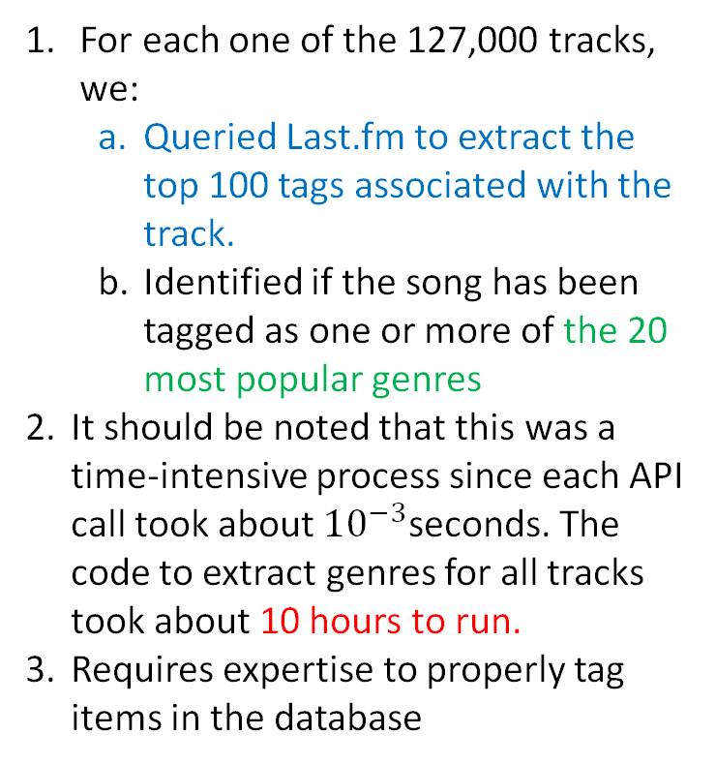
Major Challenges with the Genre-Based Filtering Approach
For each one of the 127,000 tracks, we:
Queried Last.fm to extract the top 100 tags associated with the track.
Identified if the song has been tagged as one or more of the 20 most popular genres
It should be noted that this was a time-intensive process since each API call took about ${10}^{−3}$seconds. The code to extract genres for all tracks took about 10 hours to run.
Requires expertise to properly tag items in the database

Slide 31
Advantages of the Genre-Based Filtering Approach
Most recommendation systems suffer from a problem known as the cold-start problem. In the absence of user-item interactions (a common scenario at the beginning), most filtering algorithms fail.
The genre-based approach works even in this scenario. (NO cold-start problem)

Slide 32
Collaborative Filtering based on Matrix Factorization (2 min)
Karthik Palaniappan

Slide 33
Recommends songs liked by users who like the requested song

Slide 34
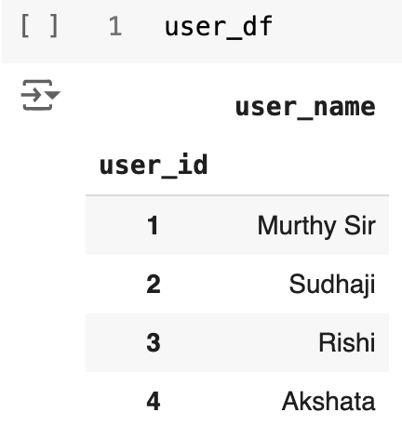
Consider the following user list

Slide 35
Sample user-item interaction
Murthy Sir | DSP - Mirchi
Sudha Ma’am | Taylor Swift
Rishi | AR Rahman
Akshata | Elvis Presley

Slide 36
What if the users were anonymized? AKA CDS Match the following!
Anon 1 | DSP - Mirchi
Anon 2 | Taylor Swift
Anon 3 | AR Rahman
Anon 4 | Elvis Presley

Slide 37
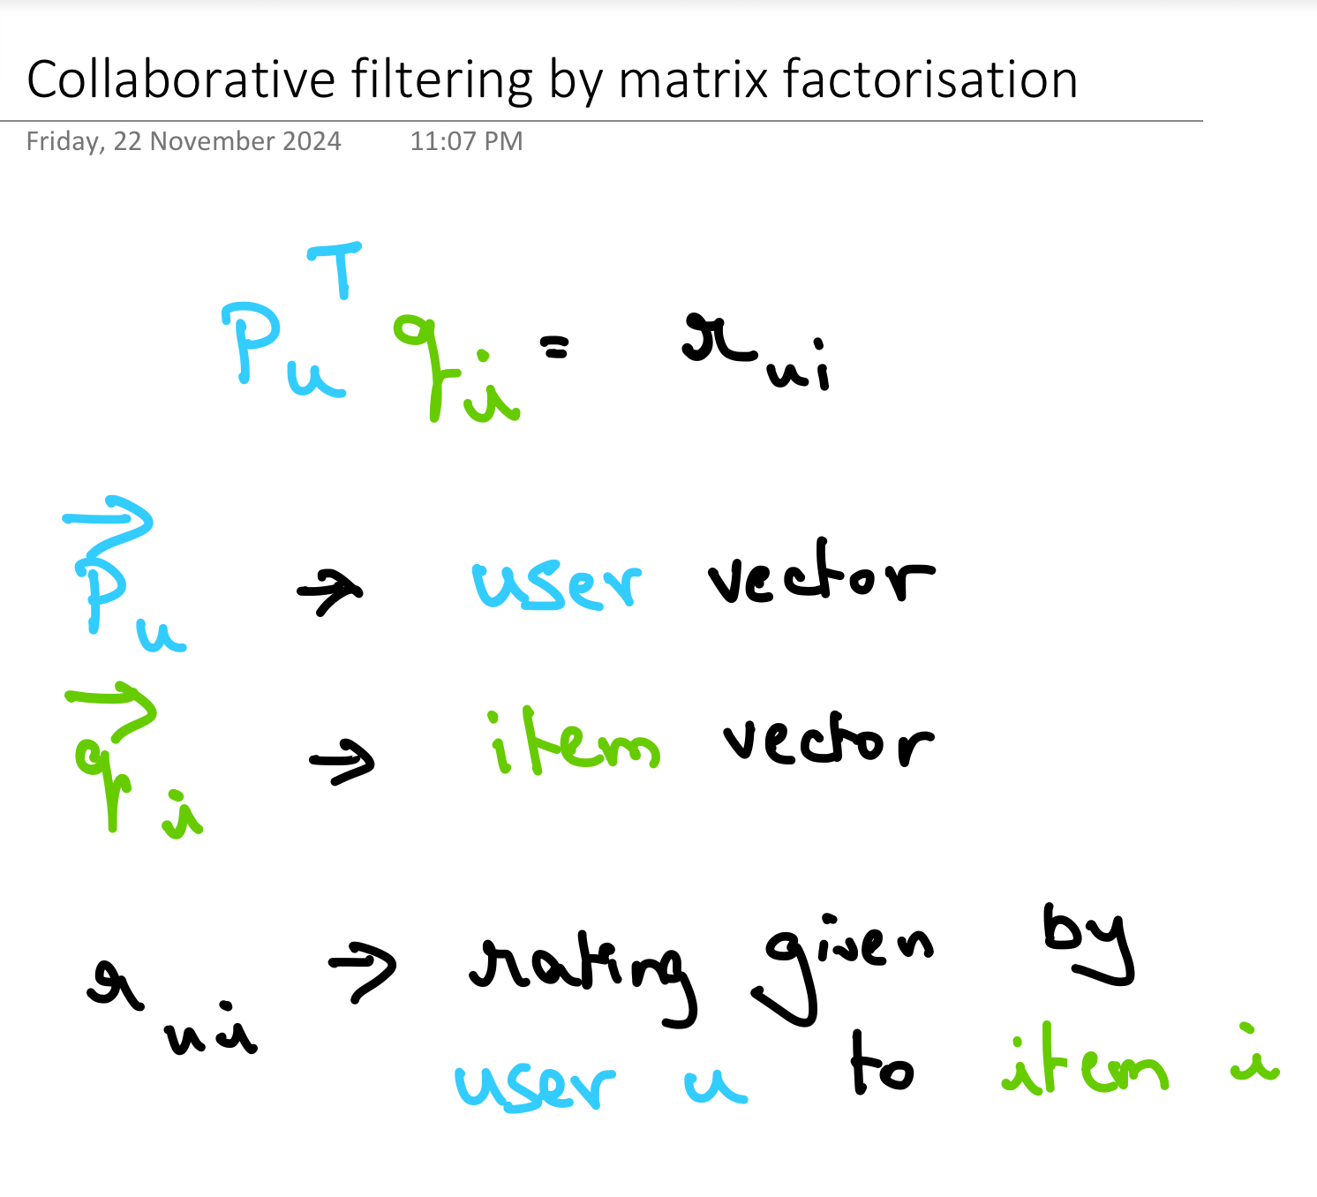
Concept of item rating

Slide 38
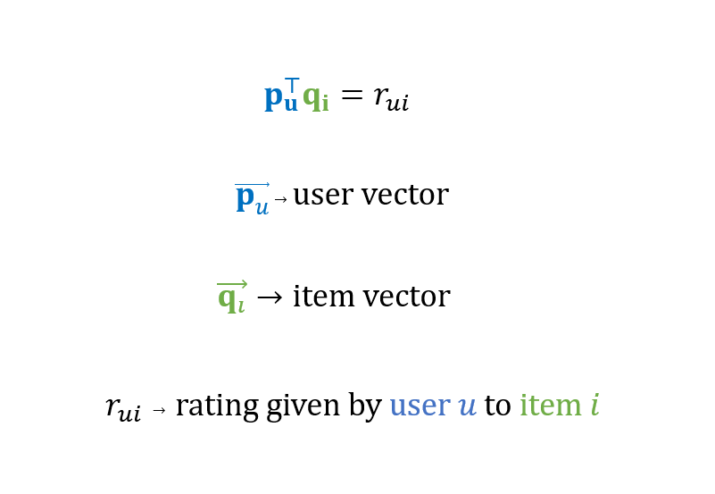
Concept of item rating – Collaborative filtering by matrix factorization

Slide 39
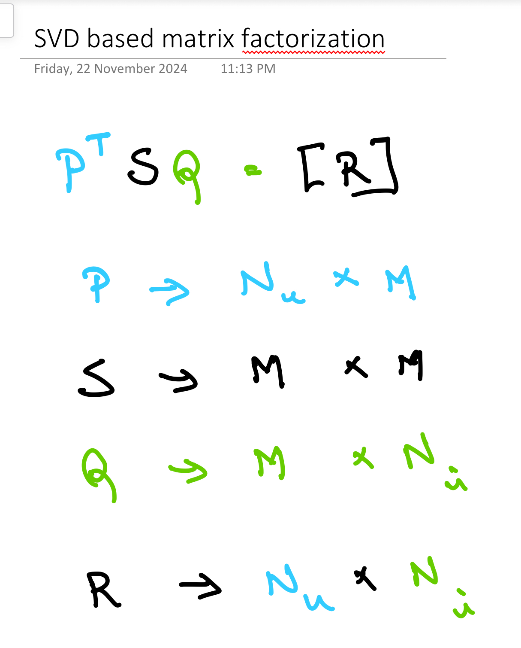
Matrix Factorization

Slide 40
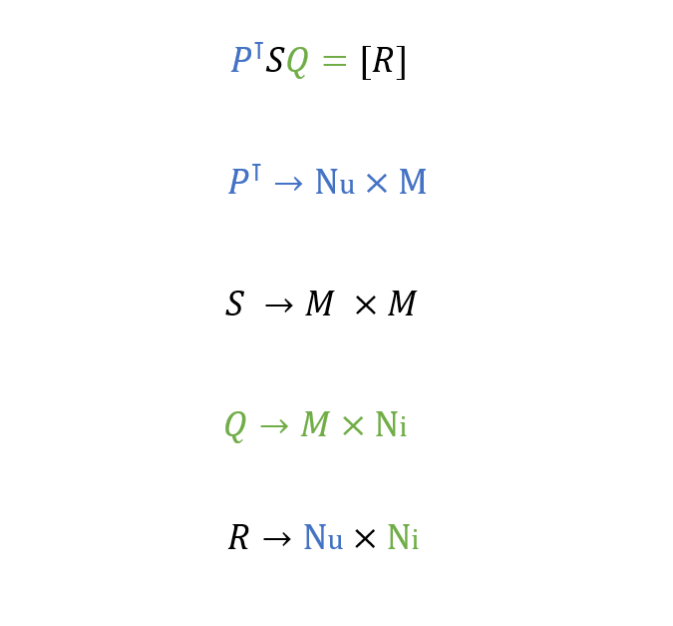
Matrix Factorization

Slide 41
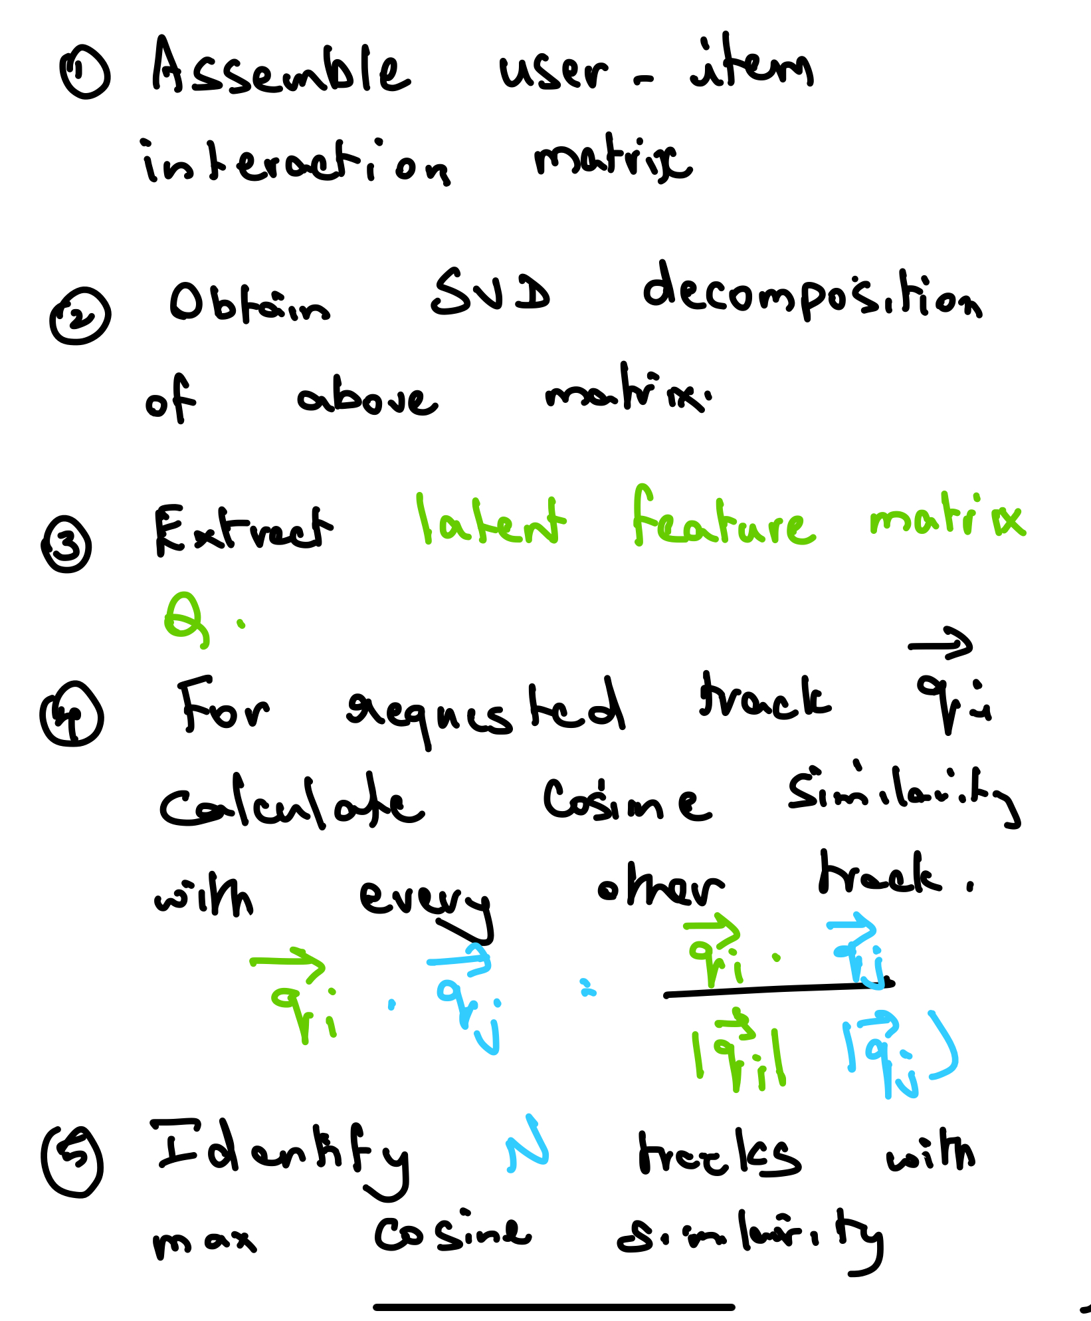
Collaborative Filtering Algorithm

Slide 42
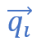
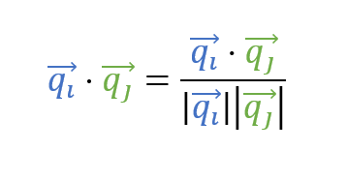
Collaborative Filtering Algorithm
1. Assemble user-item interaction matrix.
2. Obtain SVD decomposition of above matrix.
3. Extract latent feature matrix Q
4. For requested track calculate cosine similarity with every other track.
5. Identify N tracks with max cosine similarity.

Slide 43
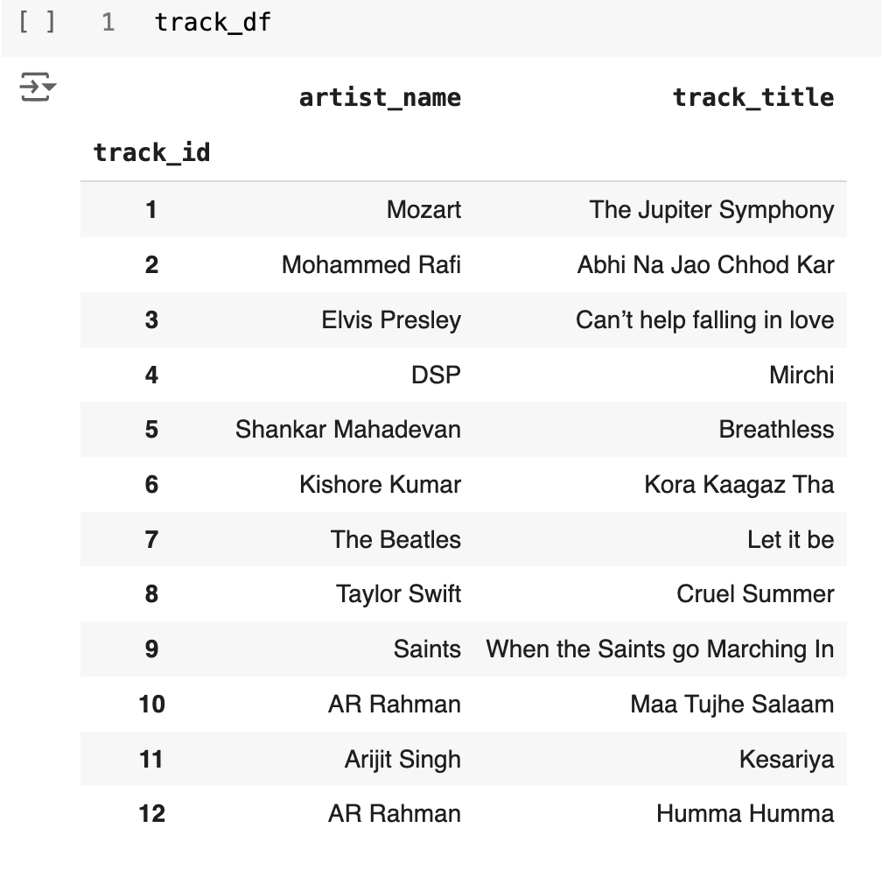
Item List

Slide 44
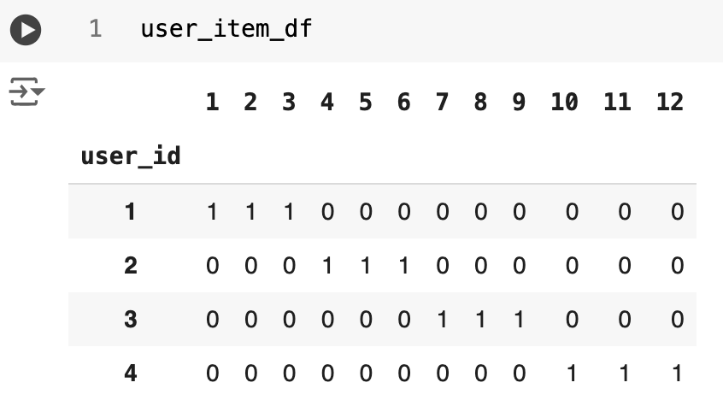
User Item Interaction Matrix

Slide 45
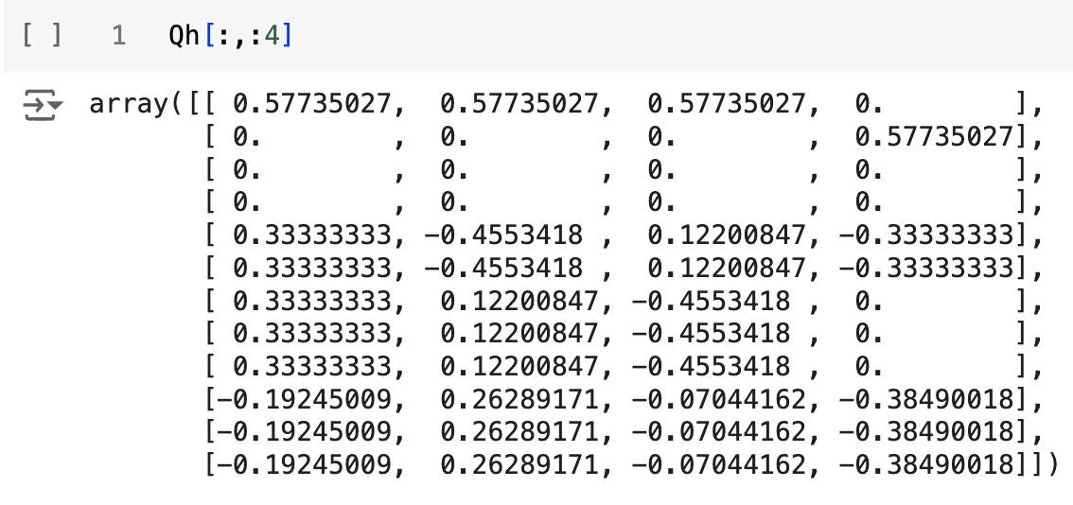
Latent feature Vectors identified by SVD

Slide 46
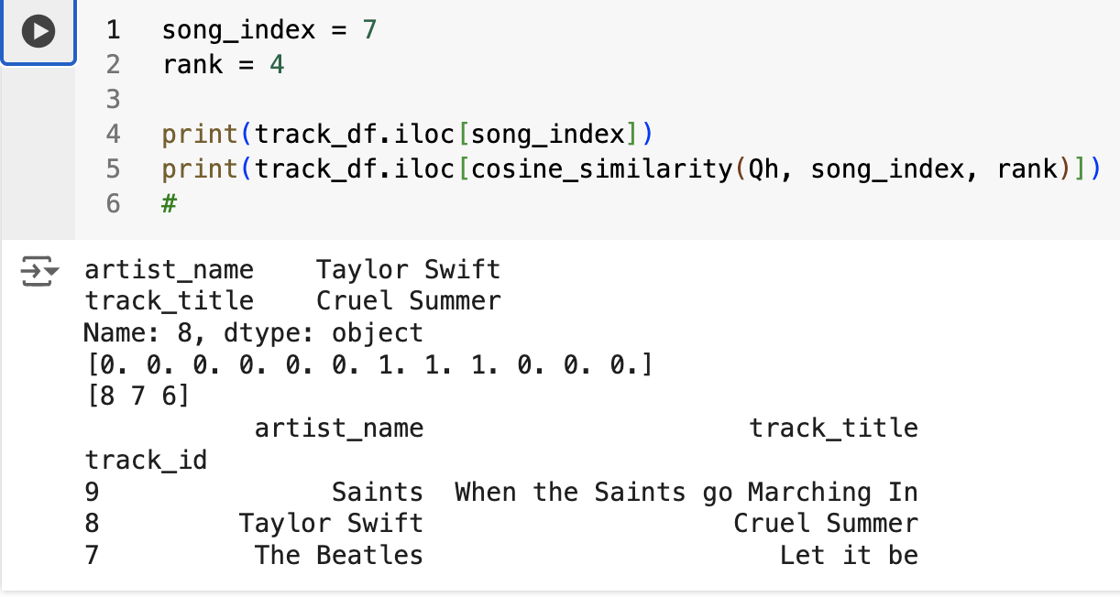
So what would a Taylor Swift fan like?

Slide 47
Surprised? Because Rishi!

Slide 48
Advantages and Disadvantages of Collaborative Filtering
We need a good number of users and items interactions before we can start making meaningful recommendations. This is often called the cold-start problem.
We don’t require subject expertise to extract the latent features of the items and the users. This is taking care of by the underlying Mathematics.
On the flip side, the feature vectors represent latent features that are difficult to interpret.

Slide 49
Item-Based Collaborative Filtering (4 - 5 min)
Srinivas Chakravarty

Slide 50
Item-Item Collaborative filtering – Concept (1/2)
Item-Item collaborative filtering is a recommendation method that looks for similar items based on the ratings given by the users. The ratings are either user has liked a certain item or interacted with it. Once similarities are found then the algorithm looks for items that user has consumed and recommends similar items.
Let's understand this with an example, suppose user X listened to songs A, B and C. Using the CF we found that song C is similar to the song D. Then the recommendation engine will suggest song D to user.
Creating User-Item Matrix
Calculating similarity score among items
Creating item-item matrix
Creating item neighbors
Calculating Rating for items that were not rated by user
Top Recommendations to User

Slide 51
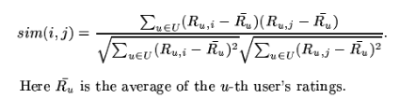
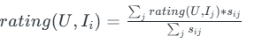
Item-Item Collaborative filtering – Concept (2/2)
Userid | Track title | Rating
U1 | T1 | 2
U2 | T2 | 3
U3 | T1 | 4
U2 | T1 | 5
U2 | T3 | 1
U1 | T3 | 1
U3 | T2 | 2
U3 | T3 | 3
U4 | T1 | 2
U4 | T2 | 3
Userid/Track title | T1 | T2 | T3
U1 | 2 | ? | 1
U2 | ? | 3 | 1
U3 | 4 | 2 | 2
U4 | 2 | 3 | ?
1
Recommend T1 to U2 and T3 for U3
6
2
Userid/Track title | T1 | T2 | T3
U1 | 2 | 1.4 | 1
U2 | 2 | 3 | 1
U3 | 4 | 2 | 2
U4 | 2 | 3 | 2.5
3
 | T1 | T2 | T3
T1 | 1 | -0.48 | -0.48
T2 | -0.48 | 1 | -0.50
T3 | -0.48 | -0.50 | 1
5
4

Slide 52
Item-Item Collaborative filtering – MMTD data
Challenges
No explicit rating
The MMTD data didn’t have explicit ratings. The ratings are calculated based on the number of tweets per track-title by the user.
Biased data set
Most of tracks had only one tweet. Removed such entries
Large data set
Collab used to crash due to RAM issue and therefore used Dask to initially load the dataset.
Many artists for the same track title
The same track title had several artists. To get unique tracks, track+artist per user is considered as track-title

Slide 53
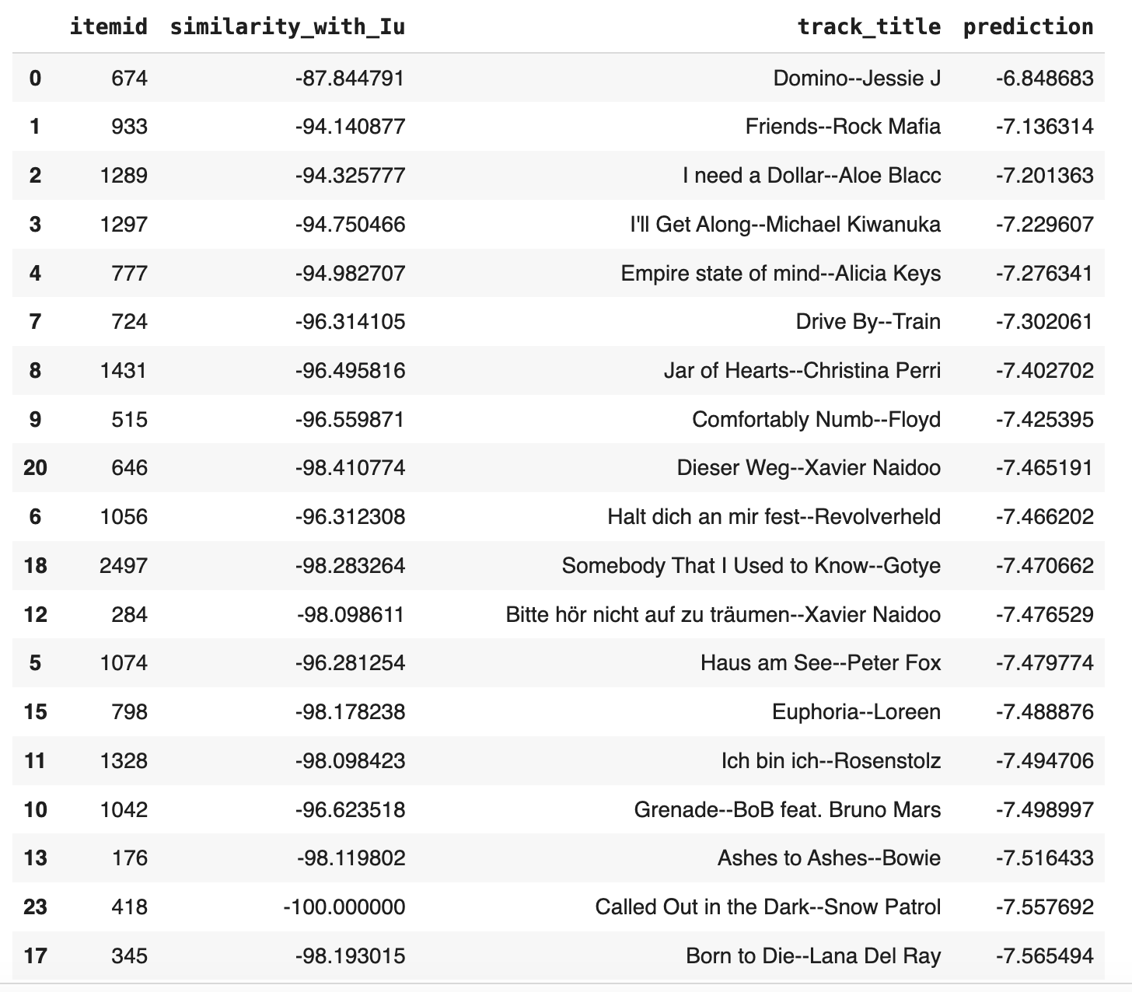
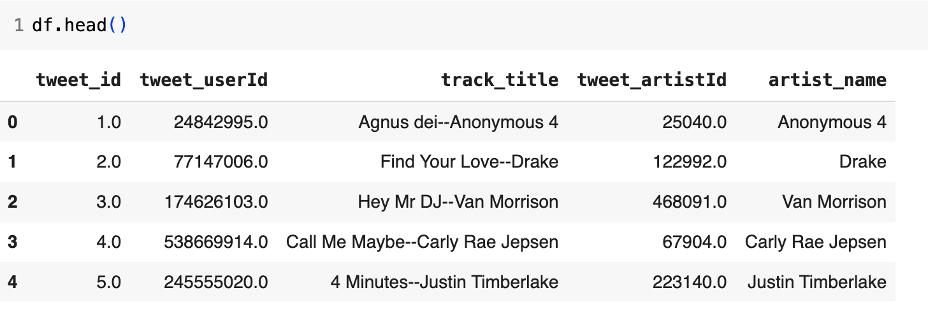
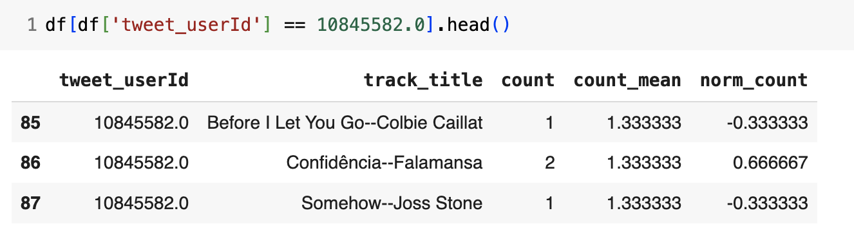
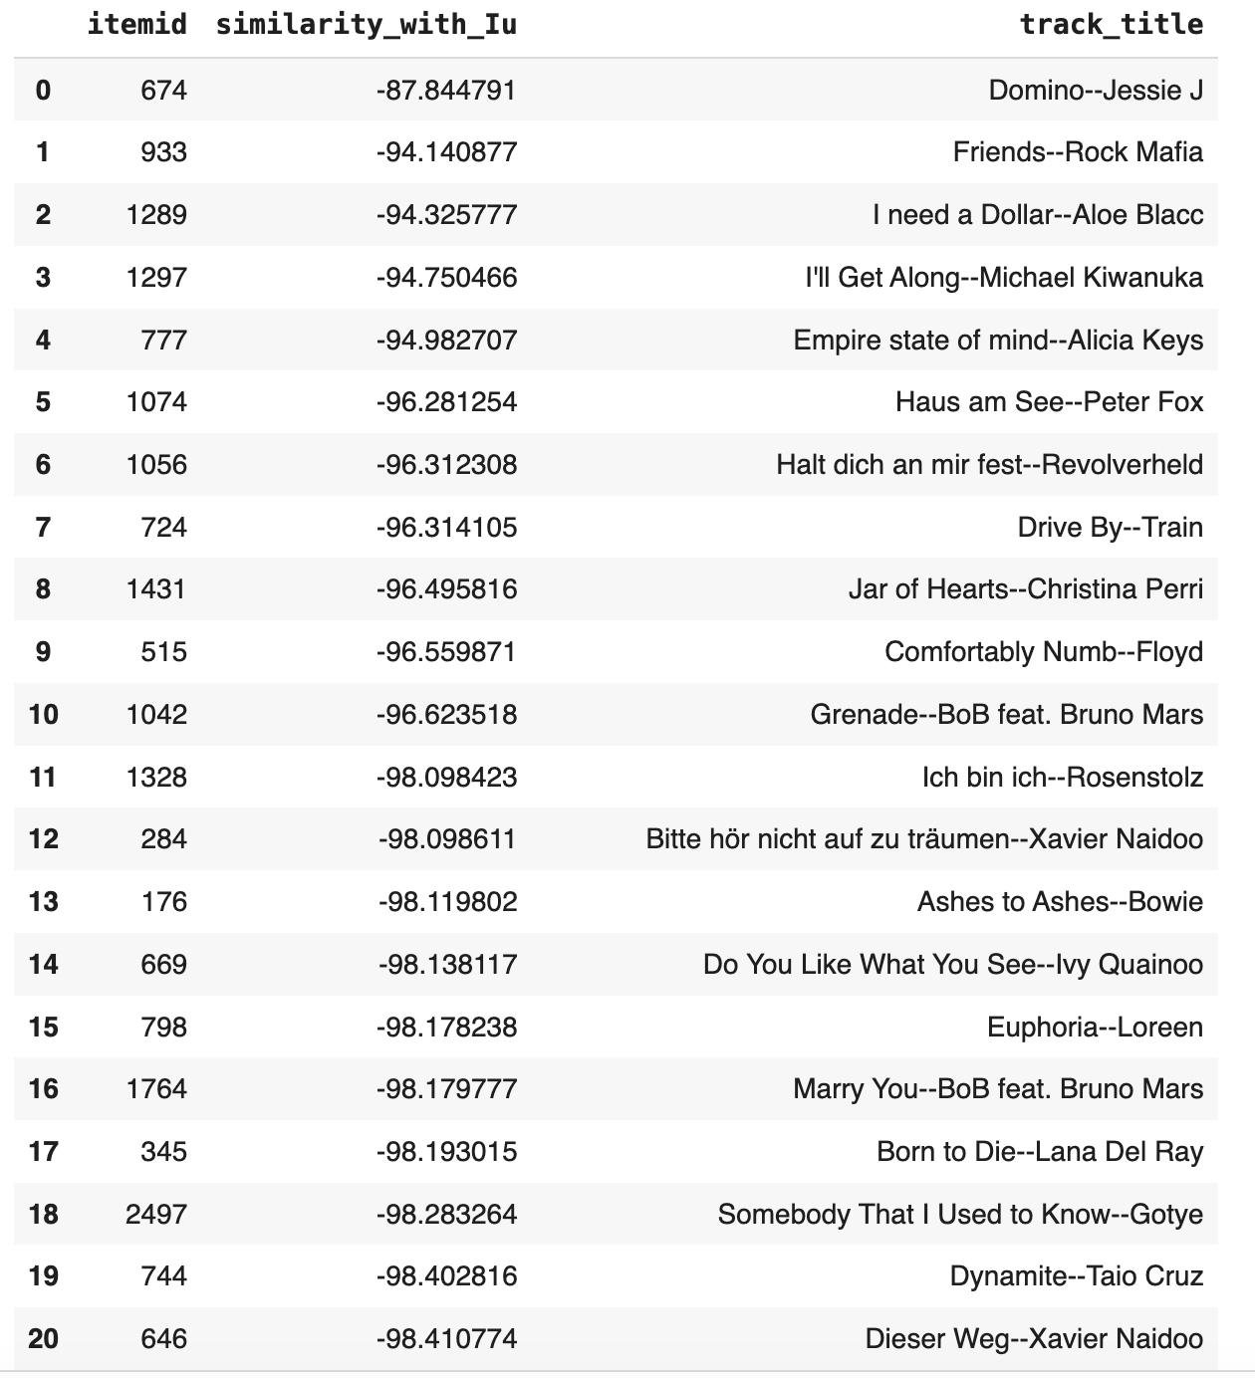
Item-Item Collaborative filtering – Actual results
Top 20 recommendations for a user
User item matrix
1
Normalizing ratings
3
Similarities/candidate recommendations
2

Slide 54
Item-Item collaborative filtering
Advantages:
The key to item-to-item collaborative filtering’s scalability and performance is that it creates the expensive similar-items table offline.
The algorithm’s online component — looking up similar items for the user’s purchases and ratings — scales independently of the catalog size or the total number of customers
Therefore, the algorithm is fast even for extremely large data
Disadvantages:
many product pairs have no common customers, and thus the approach is inefficient in terms of processing time and memory usage

Slide 55
UI Development (2 – 3 min)
Ajay Shriwastava and Praneet Nadkar

Slide 56
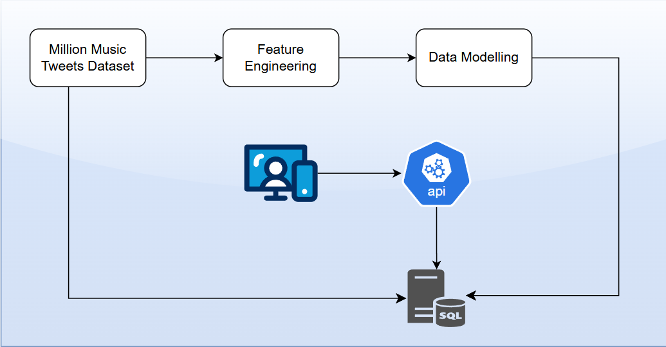
Architecture Diagram

Slide 57
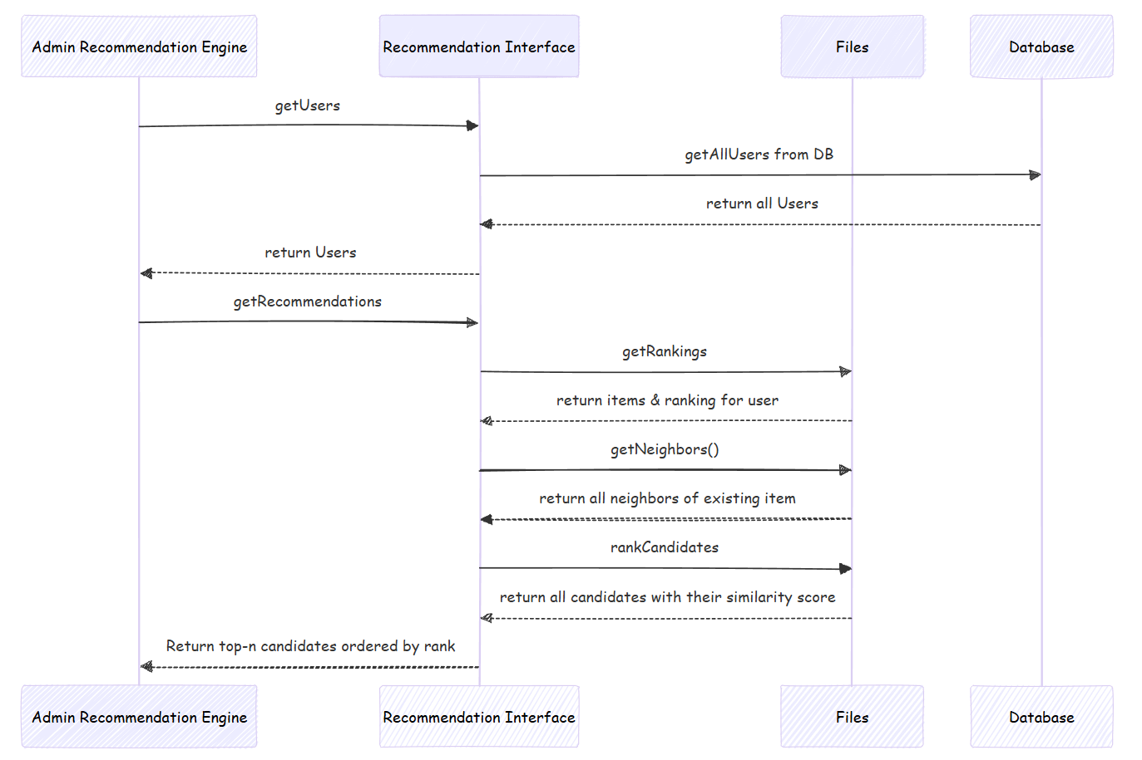
Item to item based filtering

Slide 58
UI: Tools and Technologies
Objective : To create a simple functional MVP
Web Layer.
Languages- Java Script v1.5
Web Application – Flask v3.0.3
Template Engine – Jinja2 v2.3.2
CSS Engine – Bootstrap v4.3.1
Application Layer.
Language - Python v3.10.6
Server-Side Caching – Flask-Caching 2.3.0
SQL connections – sqlite3 (Python Standard Library)
Data Store.
RDBMS – SQLite v3.46.1
SQL Query Tool – DB Browser v3.13.1
Text Files (To store Numpy Arrays and Pandas DataFrame)

Slide 59
Summary and Conclusions (1 min)
Praneet Nadkar

Slide 60
In summary
Large-scale dataset: The dataset provides a massive amount of data for training and testing recommendation systems.
Diverse music genres: It covers a wide range of music genres, allowing for a comprehensive analysis of music preferences.
Temporal and geographic information: The dataset includes timestamps and geographic locations of tweets, enabling the study of temporal trends and regional variations in music consumption.
User behavior analysis: The data can be used to analyze user behavior, such as how users discover new music, share their preferences, and interact with other users.

Slide 61
Challenges we faced
Challenges in Working with the MMTD:
Data quality: The dataset may contain noise, inconsistencies, and missing data, which can impact the accuracy of analysis and recommendations.
Data sparsity: The user-item interaction matrix may be sparse, making it challenging to capture user preferences and item similarities.
Cold-start problem: Recommending items to new users or recommending new items to existing users can be difficult due to limited historical data.

Slide 62
Future Directions (1 min)
Nilesh Tompe

Slide 63
Future Directions (1 min)
Areas for Further Research:
Context-aware recommendations: Explore how to incorporate contextual information, such as time of day, location, and social context, to improve recommendation accuracy.
Hybrid recommendation systems: Combine collaborative filtering, content-based filtering, and knowledge-based approaches to address the limitations of individual techniques.
Social influence analysis: Analyze the impact of social networks and user interactions on music recommendations.

Slide 64
Thank you!
Cohort 7, Group 7

